Slide 1
UMD Data Analysis Project
Chuwen Liu

Slide 2
Introduction
The dataset provided by Urban Ministries of Durham shows the living material support for people in need, and the time span is around 90 years (1931-2019).
Data Preprocessing and Cleaning: Clear out the extraneous variable; Transform the data type of Date; Add new variable column “year” and “month” for further exploration; drop off NA before we begin to use the variable columns.
Method: tidyverse function. ggplot2

Slide 3
Questions
We raise several questions to explore the trend of different variables and extract some conclusion from our plots and results.
1. What’s the trend of food supply based on “year” or on “month”?
2. Clothing items, school kits and Diapers: Will they have some correlation?
3. People who receive the support from UMD: Increasing Or Decreasing?
4. What is the most frequent word used in Note of Service?

Slide 4
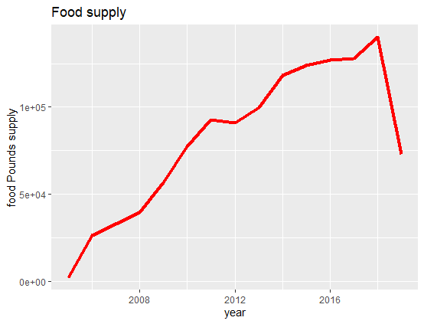
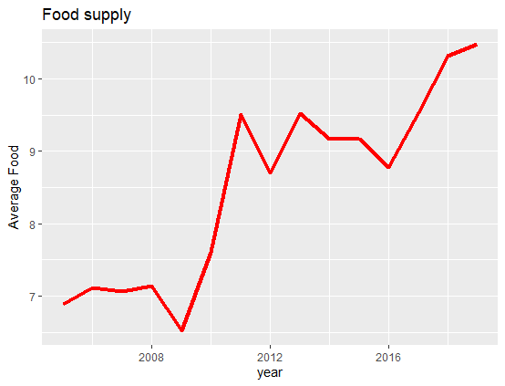
Food Supply
Consider `Food Pounds` and `Food Pounds` /`Food Provided for` (Consider the time span 2005-2019)

Slide 5
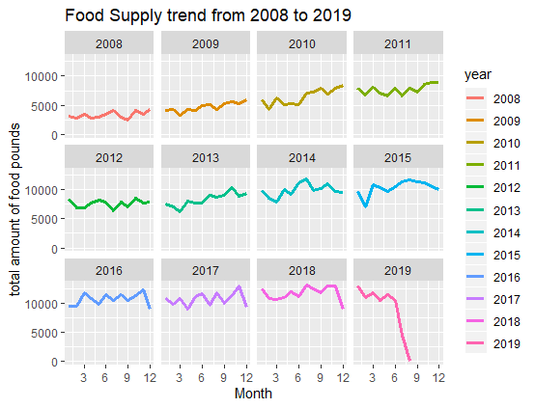
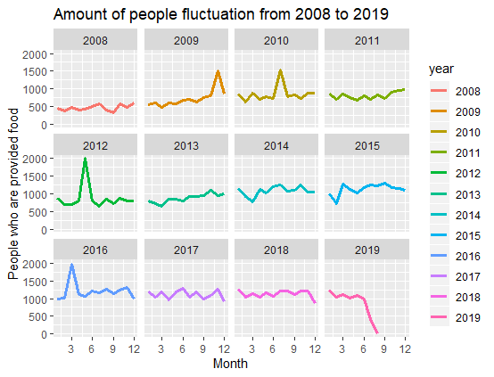
Food Supply

Slide 6
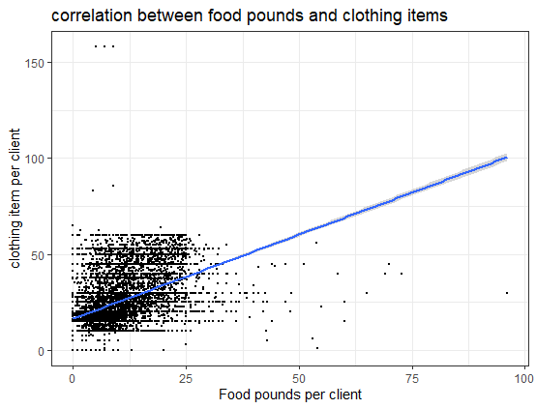
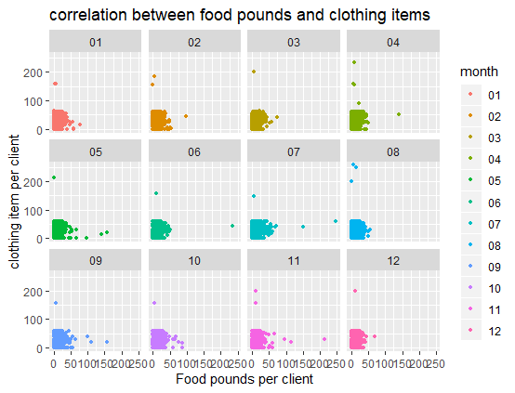
Food supply and Clothing items

Slide 7
Comments
The food demand is increasing from 2005 to 2018; and the average supply is also increasing, but not a continuous process.
After Chisq GOF testing, we find that the food supply per person has no association with month.
For people who are provided food, the amount is increasing but become stable after 2016.
Food Pounds and clothing items has linear correlation, and this correlation has little change when considering the month variable.

Slide 8
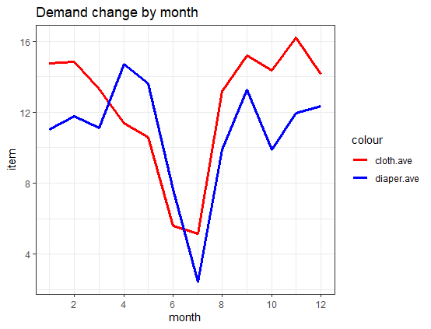
Clothing items and school kits
We could deduce from the plot that the demand is influenced by the season; (We try classified the plot by year, but the data point in some plots is too few.
Clothing item and diapers have very similar changing trend; In summer the demand decreases very quickly
Attention: We only have 688 data, which is a little part of the whole dataset. It just shows a trend in recent 15 years.

Slide 9
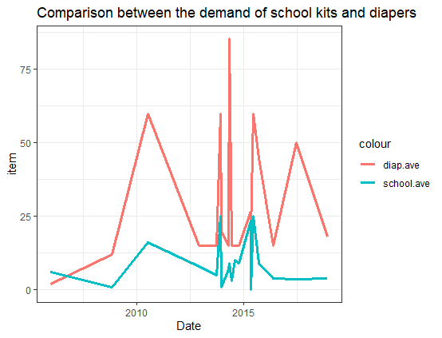
School kits and Diapers
In our mind, Babies who need Diapers will need school kits after several years; So the blue line will change after the red line.
The limit is that the data point is very few due to plenty of NA.
Conclude that there’re similar need for both school kits and diapers as for one client.

Slide 10
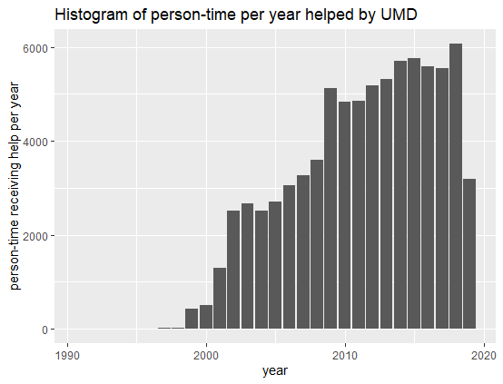
People who receive the support from UMD: Increase Or Decrease?
For person-time, it begins to increase from 1999 and has been continuously increasing;
Then we’ll see if there’s more and more new clients every year.

Slide 11
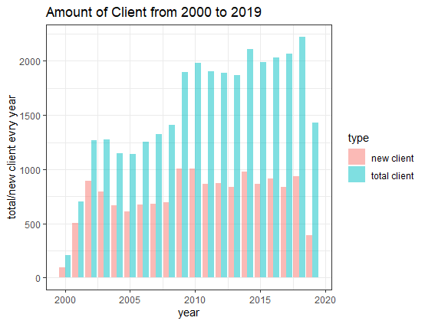
People who receive the support from UMD: Increase Or Decrease?
The “new client” means new clients who began to ask UMD for help, and “total client” means how many clients went to UMD for help that year(not person-time)
The total amount is increasing, and the amount of new clients every year is stable.

Slide 12
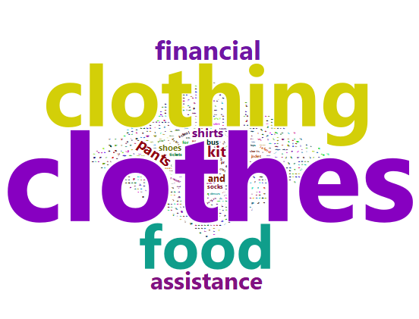
What is the most frequent word used in Note of Service?
After removing NA, we have 3187 data record in the column.
We filter the meaningless number and symbols in “note” at first.
Easy to notice that “clothing” is the most frequent words in note of service, and “food” and “hygiene” are on the heel.

Slide 13
Conclusion
The amount of people who went to UMD for help has been increasing since the late 20 century, and we notice that the demand for food supply is also increasing from 2000. Most clients sought for `clothing items` help, and the demand seems to have association with seasons.
The urban ministries still have lots of work to do since there’s no indication that the demand for food and clothing will decrease in the future.

